Slide 1
Advanced Infrared (IR) Image
Enhancement Algorithm
Stuart Recob

Slide 2
Problems with thermal images
low resolution (when compared to visual images)
low contrast
not clearly visible edges (diffused)
low image sharpness (when compared to visual images)
visible noise due to non-uniformity of array detectors,
occurrence of pulse disturbances
colour palette or grayscale representation different than human eye is used to see.

Slide 3
The stages of image enhancement
Noise Removal
Contrast Enhancement
Edge Detection and Sharpening
Optimization of Grayscale Palette

Slide 4
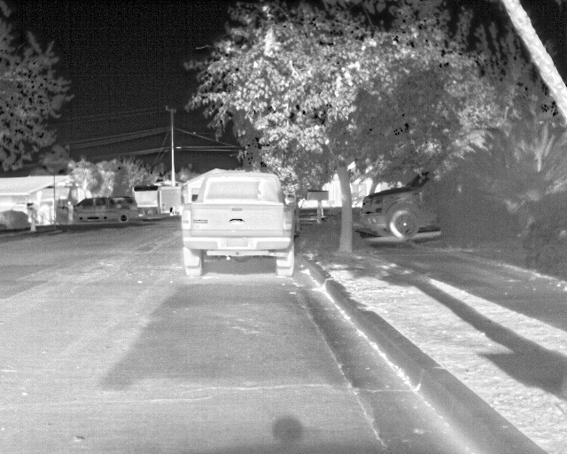

Slide 5
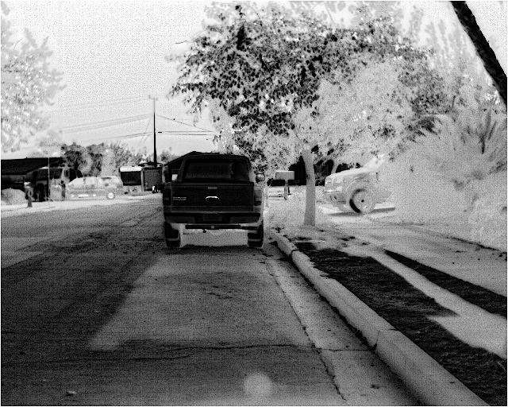

Slide 6
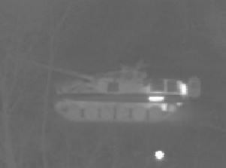
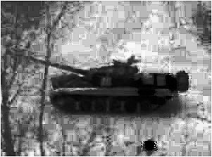

Slide 7
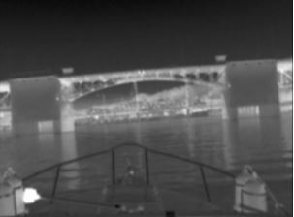
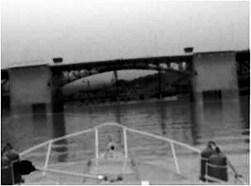

Slide 8
